Slide 1
G481/581 Terrestrial Ecosystem Modeling Hydrology in TEMs
Instructor: Dr Natasha MacBean

Slide 2
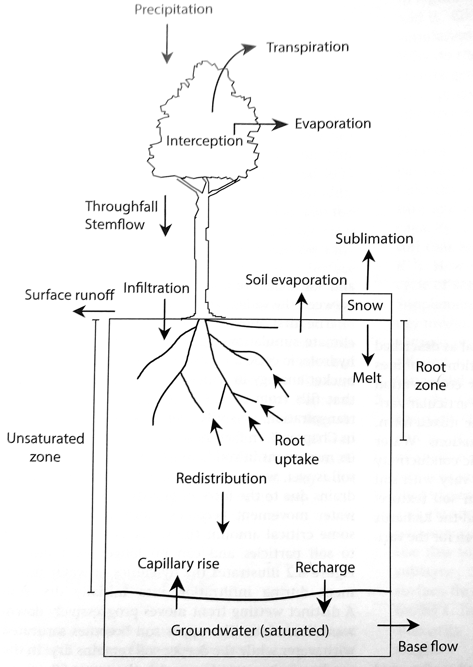
Overview
Bonan (2019) Fig. 8.1
How hydrology models have changed over time
Soil moisture
Lateral flows (briefly)
Snow (briefly)
Plant hydraulics (briefly)
How hydrology connects with other processes in models
Remaining limitations
Model evaluation
* Denotes aspects you can focus on in more depth in class project (e.g. examining how processes differ across models)

Slide 3
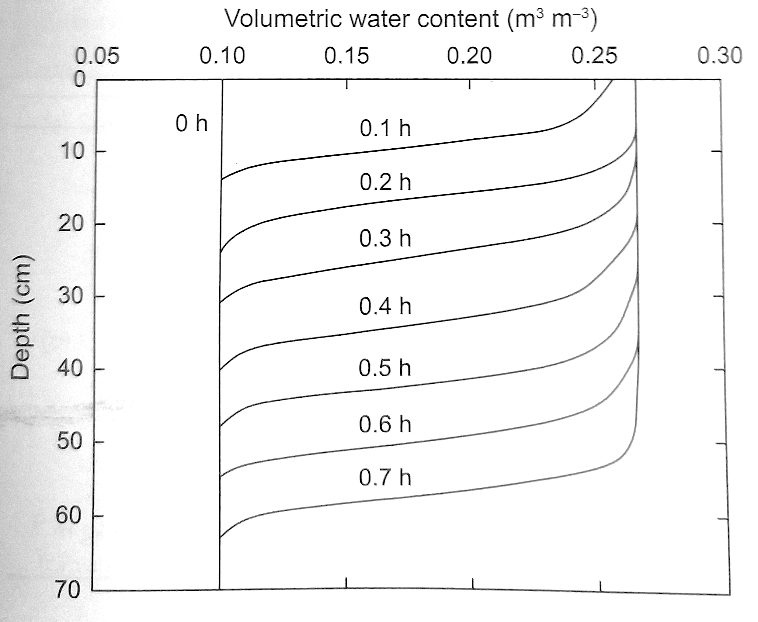
Soil moisture (𝛳)
Calculate the vertical profile → moisture movement down (and up) the soil column
Dynamics from Darcy’s Law (water flows from high to low potential) and Richards equation
Water movement has complex dependencies on soil wetness, texture etc.
Units:
Total soil water: kgm⁻²
Volumetric soil moisture: m³m⁻³
Water flux: kgm⁻²s⁻¹
Bonan (2019) Fig. 8.2
Notes:
Vertical profile important for land-atmosphere coupling: dry surface soil can impede evaporation and deeper rooted plants can extract moisture from below to sustain transpiration during dry periods.
When soil is wet, moisture is loosely held in soil and drains easily with downward gravitational force. But when soil is dry the movement of water becomes more difficult – depending on how tightly bound the moisture is to soil particles (which depends on the soil texture).
Richards equation combines Darcy’s law with principles of moisture conservation

Slide 4

First hydrology models in LSMs
Bucket approach (Manabe, 1969)
W₀ certain % of field capacity, which is a parameter (often 0.15 m³m⁻³)
→ Different models may have had slightly different representations (e.g. Bonan, 2019 p110)
dW/dt = P_{r} – R – D - E
P_{r}
E
R
W₀
W
D
Notes:
E.g. GFDL LM2 land model had representation of snowpack and snowmelt, which was never included in the ORCHIDEE 2-layer bucket version

Slide 5
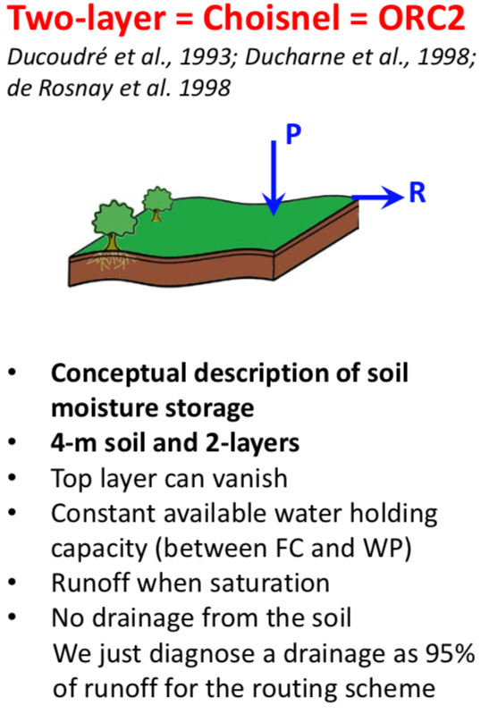
E.g. In ORCHIDEE:
Many issues:
Can’t easily evaluate
Unrealistic fluctuations in surface layer → affects E calculation
Similarly in deeper layers → affects T calculation
Simplistic description of Runoff and Drainage
Simple parameters → no account taken of soil texture and how it affects capacity or moisture conductivity
Notes:
E.g. GFDL LM2 land model had representation of snowpack and snowmelt, which was never included in the ORCHIDEE 2-layer bucket version

Slide 6
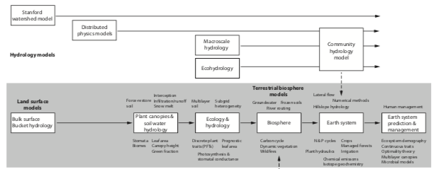
Evolution of hydrology models in LSMs over time
Move to include more mechanistic processes of moisture flow in unsaturated soils
→ related more to soil texture and forces on water movement in wetter vs drier soils
Lagged behind hydrology models

Slide 7
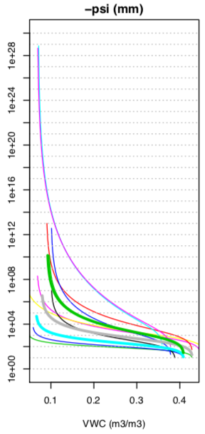
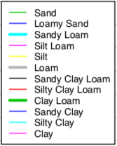
Mechanistic processes (1)
Two forces exerted on moisture in soil:
Gravitational potential (height z above a reference height)
Matric potential (ѱ), which binds moisture to soil particles (adsorptive force).
Matric potential (also called suction) varies with soil moisture (𝛳) → soil moisture retention curve
non-linear and depends on soil texture
Increases with drier soil
Psi (ѱ) negative (<0) for unsaturated soils → -psi = suction
Different ways to describe these relationships (Table 8.2 in textbook)
Van Genuchten commonly used → 2 parameters
So-called pedotransfer functions relate soil texture to parameters of retention curves
→ In models, look-up tables from several studies use pedotransfer functions to link soil texture to hydraulic parameters of retention curve
Notes:
Water loosely bound to sandy soils and more tightly bound to clay soils.

Slide 8
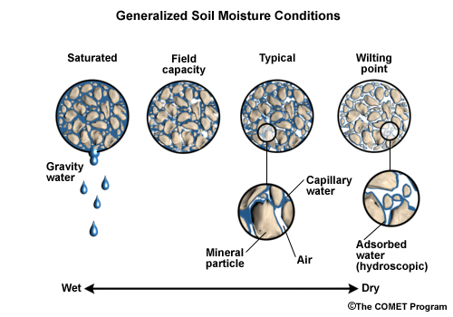

Slide 9
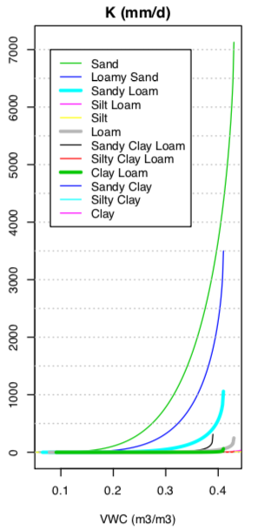
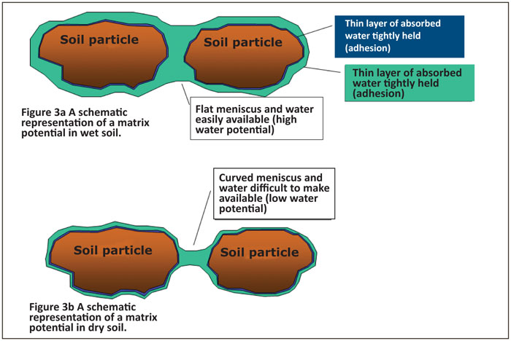
Mechanistic processes (2)
Total potential = ѱ + z
Work required to move water at some elevation and ѱ to another.
Hydraulic conductivity, K, controls rate of moisture flow from over a unit gradient in total potential
K also nonlinear and dependent on soil texture
K also decreases as soil dries
Notes:
As soil dries, suction (matric potential) increases because pores not filled with water anymore and the links between the pore water become discontinuous.
Main difference with bucket model in which water could just fill up bucket – none of these complexities were represented

Slide 10
Mechanistic processes (3)
Darcy’s Law: q = -K(𝛳) 𝛿(ѱ+z)
𝛿z
→ q = -K(𝛳) 𝛿ѱ + K(𝛳) 𝛿z
Flux of moisture (q) related to hydraulic conductivity and the vertical gradient in total water potential
Notes:
Darcy’s law describes how water moves in unsaturated medium → Flows from high potential to low potential
In wetter soils, gravitational pull is high and moisture moves down the soil column (as shown earlier)
As soil dries, matric potential is stronger (more negative, decreases) and the adsorptive force binding water to soil eventually exceeds the gravitational force pulling water downward. ALSO lower K in drier soils restricts movement.

Slide 11
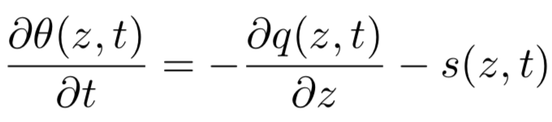
Mechanistic processes (4)
Track flux of water over time and conserve water in time and space → Richards equation (moisture based version)
Change in mass of water, 𝛳, vertically down profile related to the flux of moisture downward (as well as s, which is the evapotranspiration “sink” term)
Notes:
Moisture based version only works in unsaturated zone because moisture doesn’t vary within saturated porous medium.
Other versions – see textbook p122.

Slide 12
Representation in TEMs
K depends on 𝛳 → K(𝛳)
Relationship between K and 𝛳 not independent of relationship between 𝛳 and ѱ
Also need to know K at saturation (K_{sat})
All relationships nonlinear → therefore, need numerical methods to solve.
→ Different models use different ways to solve, or parameterize, these equations*

Slide 13
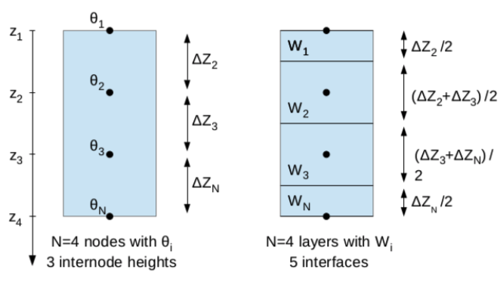
Model implementation
Non-linear equations → no analytical solution → we need numerical method (finite difference scheme)
Use changes over depth → need vertical discretization → and changes over time
Assume linear variations between consecutive nodes
weighted contributions of the moisture in the layers above and below and water flow at the current and future timestep to calculate the value for that layer for the current timestep

Slide 14
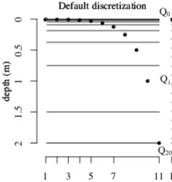
Model implementation
Finer discretization needed near the surface where soil moisture gradients can be high
Have to set soil at certain depth

Slide 15
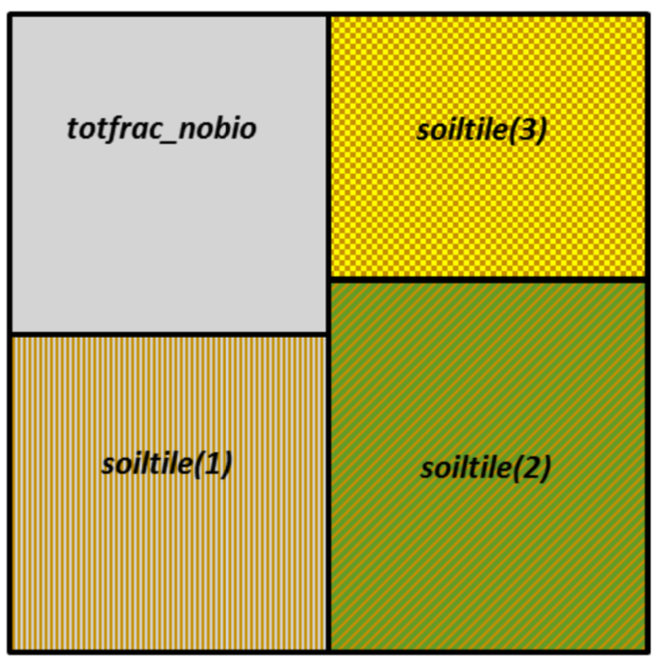
Model implementation
One soil column per grid cell?
OR soil hydrology budget for each PFTs or groups of PFTs?
In ORCHIDEE: groups of PFTs
Crops
Grasses
Forests

Slide 16
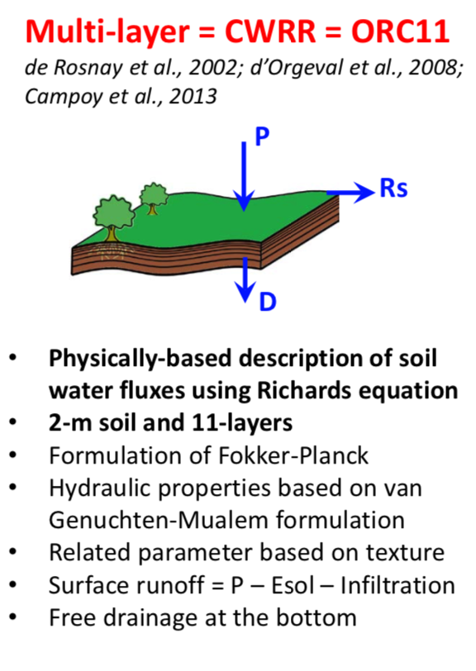
Associated processes that changed due to increased hydrology model complexity
In ORCHIDEE for example:
Partitioning of precipitation that infiltrates into soil vs runoff calculated as a function of K (therefore, dependent on soil saturation and soil texture)
Free drainage allowed at bottom of soil
Parameters such as field capacity, wilting point, etc dependent on soil texture (in addition to Van Genuchten parameters)
Notes:
Infiltration into clay is slower than sand for example

Slide 17
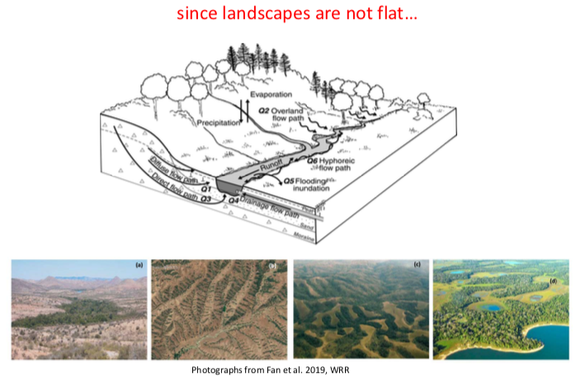
Spatial heterogeneity and Lateral flows: How can we account for hillslope soil moisture heterogeneity?*
Ducharne, A

Slide 18
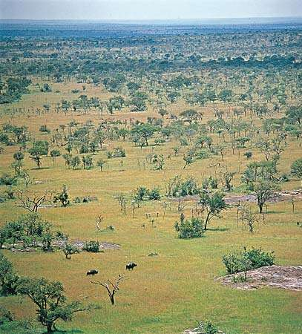
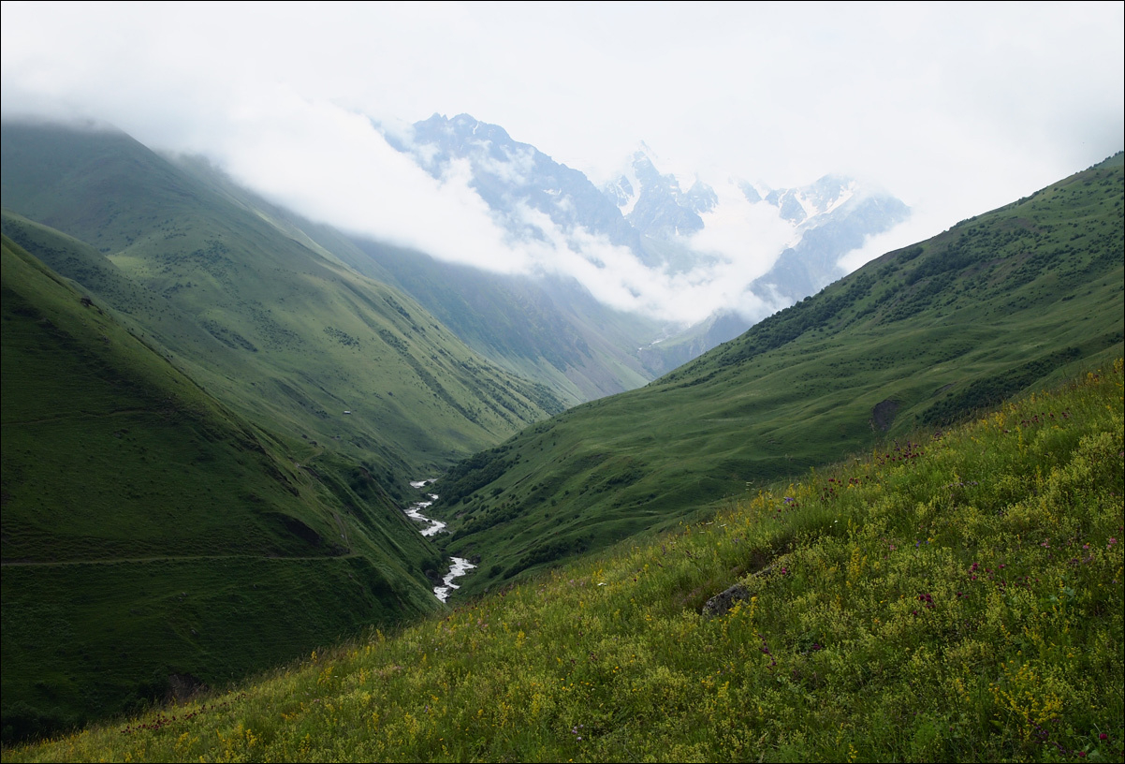
Spatial heterogeneity and Lateral flows*
Sub-grid heterogeneity of surface properties (soil texture, vegetation type, open vs closed canopy, sunlit vs shaded leaves) → changes in water/energy fluxes
Runoff → River routing →Flooding based on topography (e.g. TOPMODEL watershed model)
How do you solve these sub-grid issues?
Finer mesh?
Tiling of vegetation types/soil texture
Statistical distributions?
Stochastic processes?
Sub-grid tiling based on more than just PFTs (also soil texture, depth, elevation etc)

Slide 19
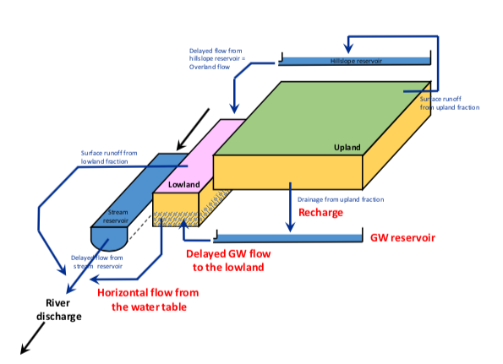
River routing in ORCHIDEE
Ducharne et al. in prep.

Slide 20
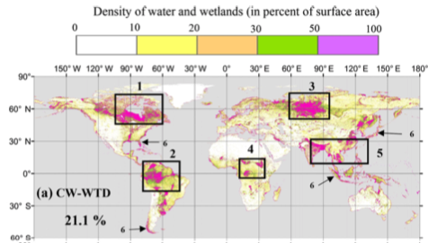
River routing in ORCHIDEE
Lowland fraction prescribed from wetland fraction
Tootchi et al. (2019)

Slide 21
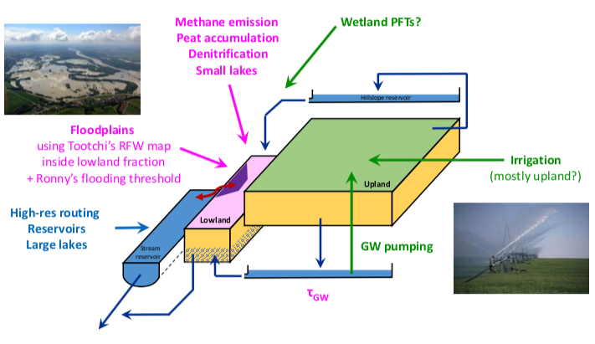
Adding further complexity in the future…?
Ducharne et al. in prep.

Slide 22
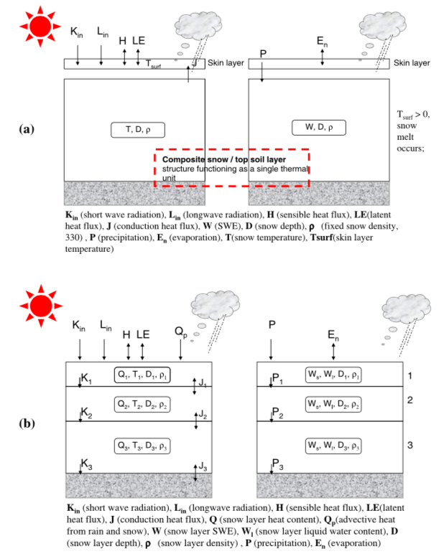
Snow*
Important for thermal budget → changes in albedo, thermal insulation and energy budgets
Older versions of snow had one layer → didn’t have vertical temperature and density gradients
Newer versions → multi-layer snow and snow ageing
Also, sublimation, compaction water percolation and refreezing
Differences between models!
Wang et al. (2013): new ORCHIDEE snow scheme
Notes:
Snow has much lower thermal conductivity than soil, so insulates the surface
Vertical temp and density gradients didn’t allow for right insulation and impact on energy fluxes. Also no physical/mechanistic representation of snow ageing allowed for changes in density and albedo.
Layers in multi-layer scheme have specific thicknesses, density, temperature and liquid water and heat content. Updated each timestep with snowfall (or lack thereof, if still snow on ground)

Slide 23
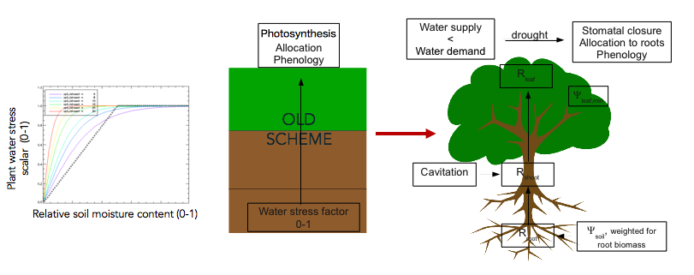
Plant hydraulics*
Either empirical function (water-limiting scalar between 0 and 1) based on soil moisture → limits photosynthesis and/or evapotranspiration
OR mechanistic process describing flow of moisture based on difference in matric potential between root zone and leaves and resistances to moisture flow
→ Empirical water stress limitation factor
→ Mechanistic coupling between plant carbon and water cycles
De Kauwe et al. (2015) → empirical plant water stress functions in TBMs don’t capture drought well
Naudts et al. (2015); Bonan et al. (2014); Ch 13 textbook

Slide 24
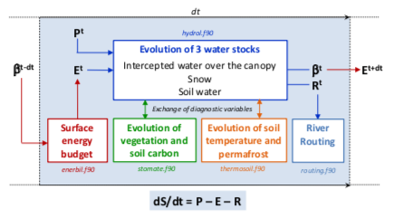
How hydrology connects with other processes in TEMs

Slide 25
Differences between models*
Which methods used to solve governing equations for movement of water (Richards equation)
How parameterize model fluxes (including infiltration, evaporation/transpiration and moisture flux between layers)
Which studies/relationships used to define model parameters
Lower boundary (groundwater or not)
Spatial discretization/representation in hydrology models → River routing
Clark et al. (2015) WRR

Slide 26
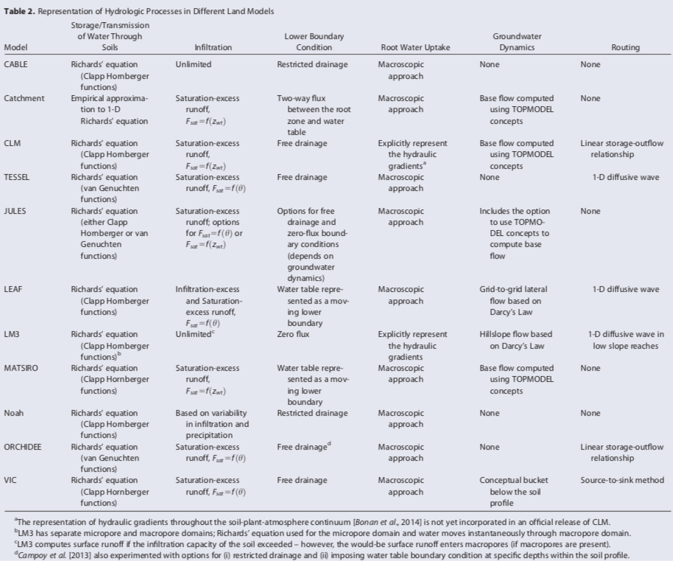
Differences between models*
Clark et al. (2015) WRR

Slide 27
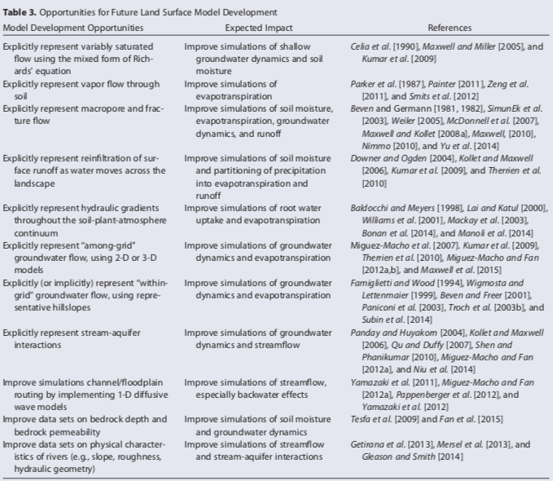
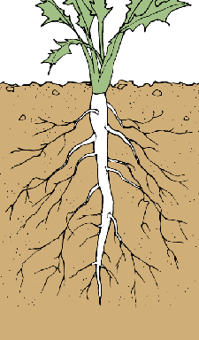
Limitations of current models and future developments needed*
Plant root water access to moisture (particularly as soil dries) and hydraulic redistribution
Representation of groundwater and exchange with bottom of soil
Spatial heterogeneity not assumed
Complexity of Lateral moisture flows
Coupled human-hydrological systems
E.g. role of irrigation, flooding risk scenarios
Clark et al. (2015) WRR
Notes:
For example, How is ET partitioned to root water uptake in each soil layer? Common method uses root density profile (itself a simple exponential function with curve defined by PFT) that is weighted by a soil wetness factor (same as water limitation function). Soil moisture in each layer than partitioned to ET based on relative root fraction of that layer. But if have mechanistic root water uptake with plant hydraulic scheme then more based on physiological principles.

Slide 28

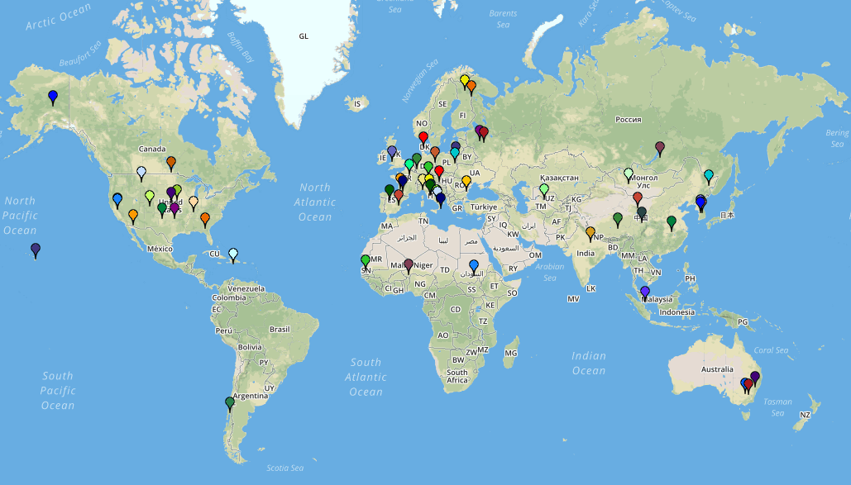
Model evaluation
International soil moisture network (in-situ soil moisture measurements)
https://ismn.geo.tuwien.ac.at/en/
Soil moisture data often available at FLUXNET and Ameriflux sites

Slide 29
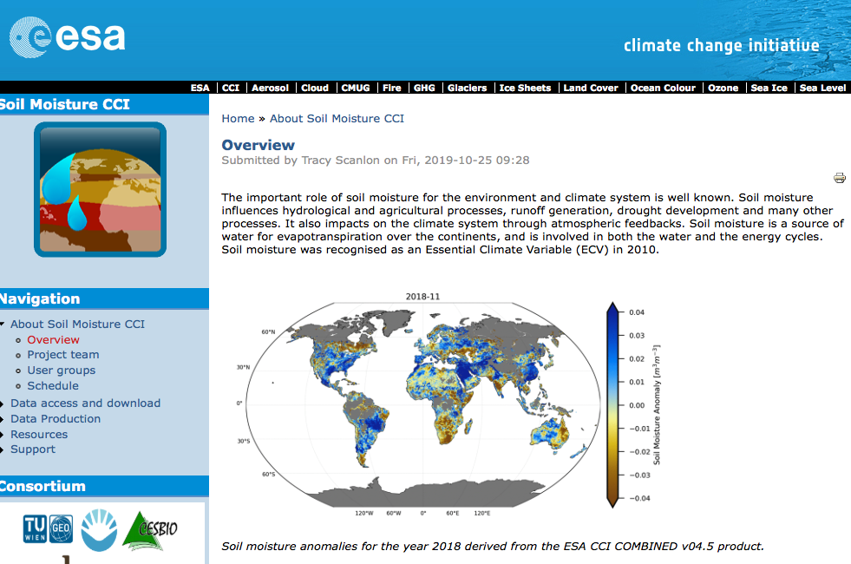
Model evaluation
Microwave remote sensing (e.g. https://www.esa-soilmoisture-cci.org)
Microwave brightness temp or backscatter sensitive to moisture in canopy and soil

Slide 30
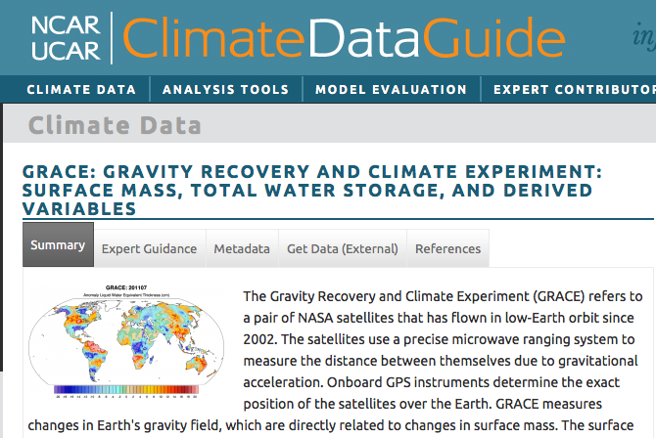
Model evaluation
Total water storage from satellite gravity measurements (e.g. GRACE)
https://climatedataguide.ucar.edu/climate-data/grace-gravity-recovery-and-climate-experiment-surface-mass-total-water-storage-and

Slide 31
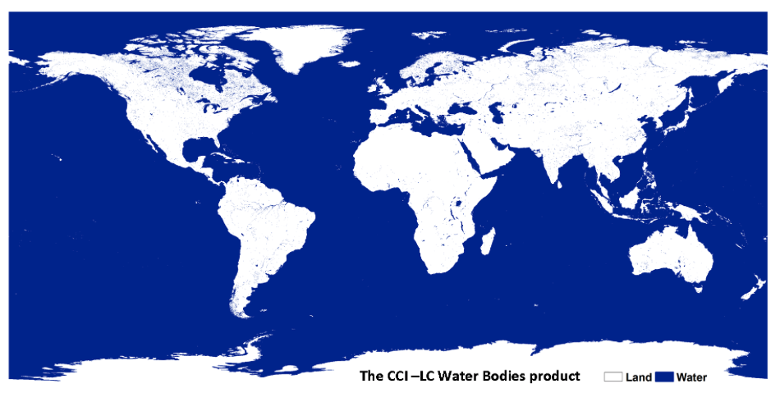
Model evaluation
Satellite wetland/water body mapping
https://www.esa-landcover-cci.org/?q=node/162

Slide 32
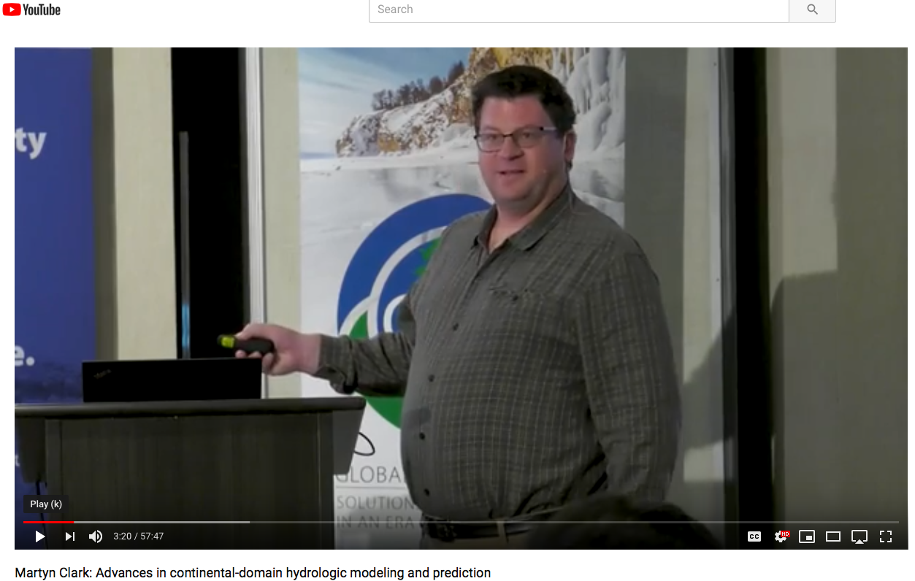
Great overview of hydrology modeling developments
By Martyn Clark: https://www.youtube.com/watch?v=tt-xCJD42CA

Slide 33
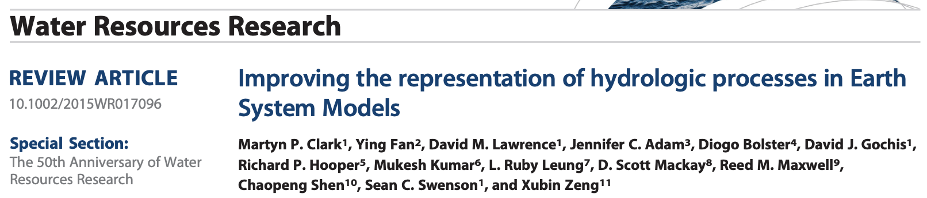
Next Wed in Class: Introductory paper discussion
Notes:
Expecting grad students to be at a higher level.

Slide 34

Next Wed in Class: Introductory paper discussion
Notes:
Expecting grad students to be at a higher level.

Slide 35
Next Wed in Class: Introductory paper discussion
Submit the 1 page document as a word or pdf document at 9am before the start of class on 8th September.
Notes:
Expecting grad students to be at a higher level.

